Slide 1


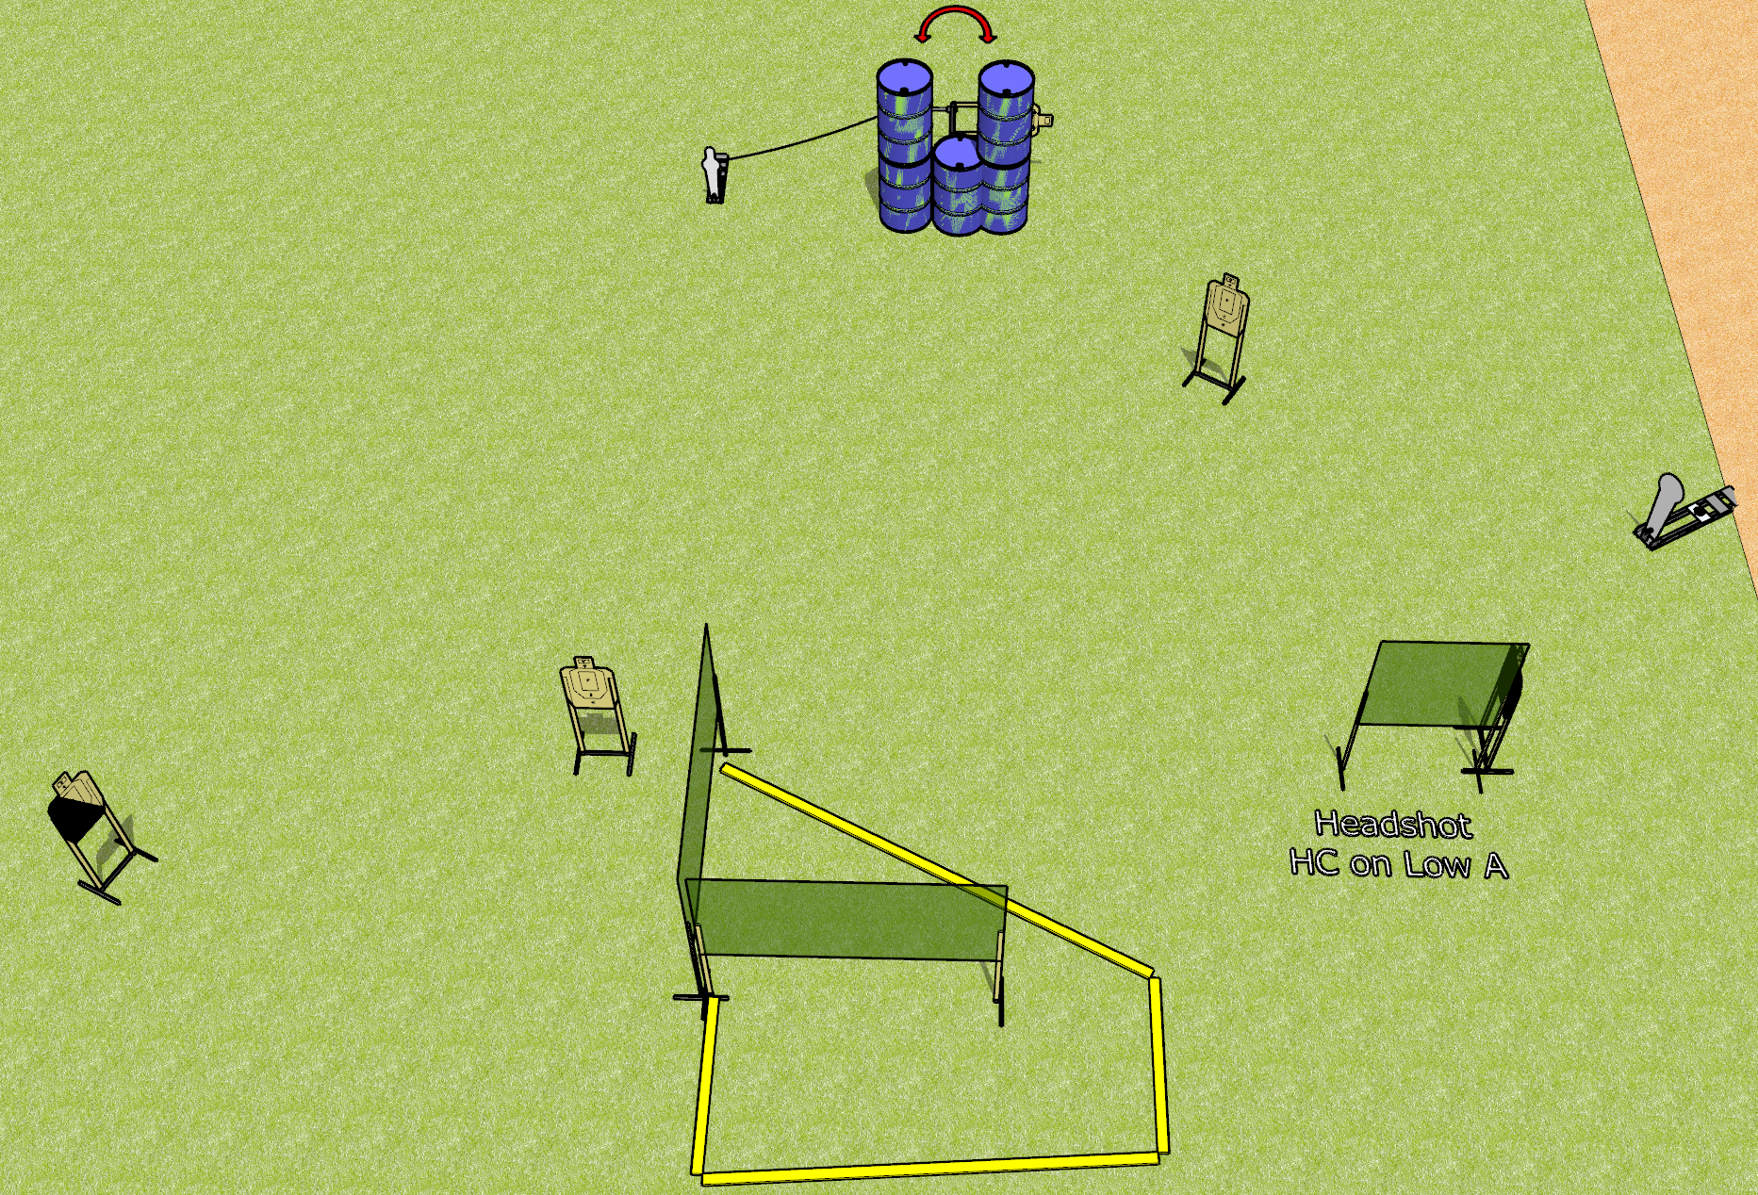
 | Dothan Gun Club – USPSA Match The Long Way Round Course Designer : Drew Coleman
12 rounds 5 USPSA targets 1 colt popper, 1 mini popper
Equipment List 1 swinger + activator 5 wall feet 1 left diagonal, 1 headshot (tape on top of lower A) Use an 8 foot wall instead of the 4 foot

Slide 2
The Long Way Round
Written Stage Briefing
The Long Way Round is a 12 round, 60 point, Comstock short course. There are 5 USPSA targets, 1 colt popper, and 1 mini popper. The best 2 hits on paper will score, and steel must fall to score. The start signal is audible.
The swinger is activated by the mini popper. Please check the activator prior to walkthrough and set it the same way every time.
Handgun start position is anywhere outside the shooting area, wrists below belt. Handgun is loaded and holstered.
PCC start position is anywhere outside the shooting area. Loaded carbine is held with both hands, stock on belt, safety on.
On start signal, engage targets as they become available from within the shooting area.

Slide 3
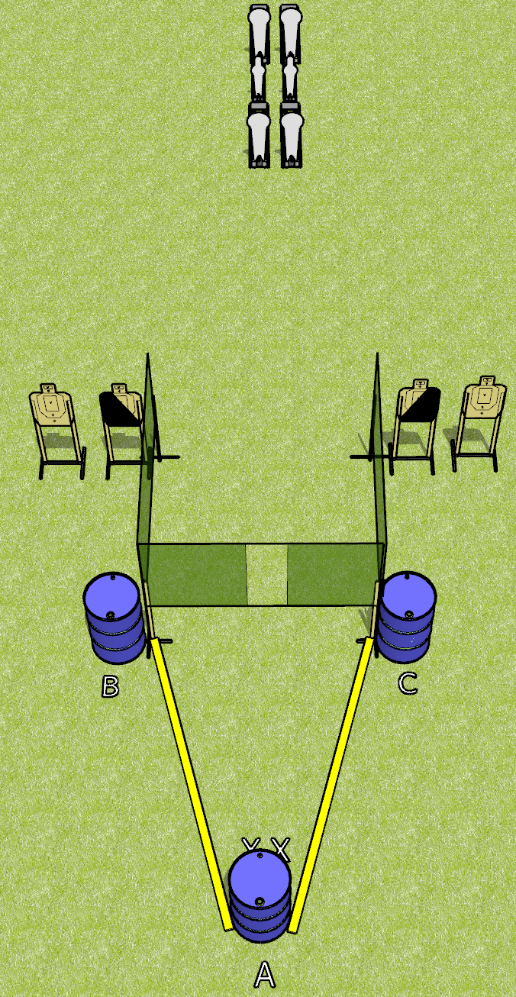
 | Dothan Gun Club – USPSA Match Borrowed from Jake Course Designer : Jake Martens
Round Count 14 rounds 4 USPSA targets 4 colt poppers, 2 mini poppers
Equipment List 4 wall feet

Slide 4
Borrowed from Jake
Written Stage Briefing
Borrowed from Jake is a 14 round, 70 point, Comstock medium course. There are 4 USPSA targets, 4 colt poppers, and 2 mini poppers. The best 2 hits on paper will score, and steel must fall to score. The start signal is audible.
Start position is toes touching X’s, facing uprange, both hands touching top surface of barrel A. Firearm is placed on barrel B OR barrel C, unloaded and unpropped. All magazines to be used on the stage must be placed on a barrel WITHOUT the firearm, including barrel A.
On start signal, engage targets as they become available from within the fault lines.

Slide 5
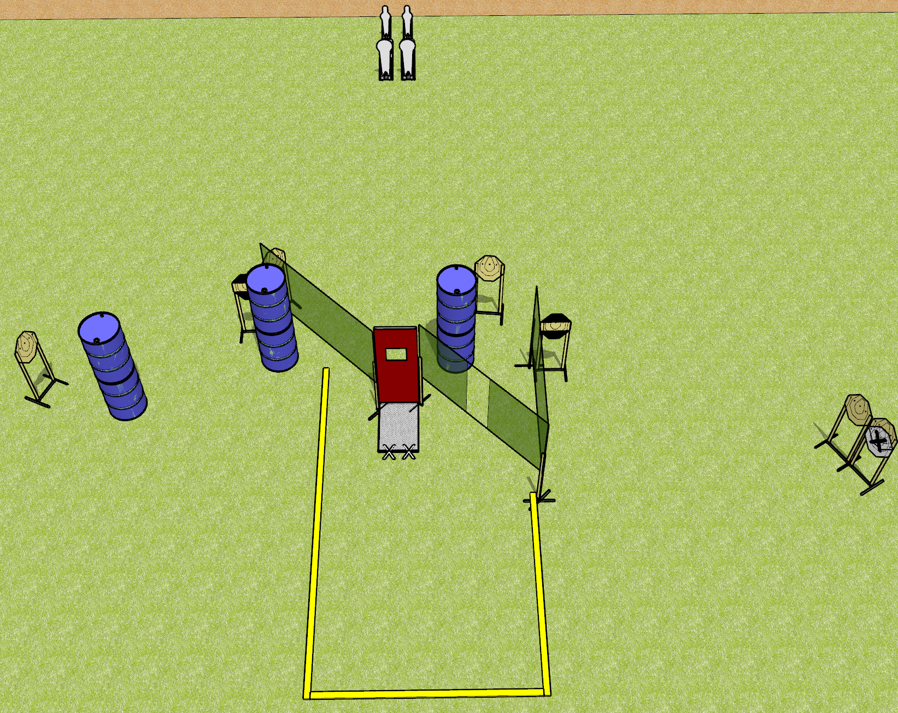
 | Dothan Gun Club – USPSA Match Despicable Course Designer : Drew Coleman
18 rounds 7 IPSC 2 Colt poppers, 2 mini poppers
Equipment List 6 wall feet 1 pull port 2 horizontal hard cover

Slide 6
Despicable
Written Stage Briefing
Despicable is an 18 round, 90 point, Comstock course of fire. There are 6 IPSC targets, 2 colt poppers, and 2 mini poppers. The best 2 hits on paper will score, and steel must fall to score. The start signal is audible.
Window prop must be closed with pull cord hanging unsupported and untouched.
Handgun start position is toes on X’s, wrists below belt. Handgun is loaded and holstered.
PCC start position is toes on X’s. Loaded carbine is held with both hands, safety on.
On start signal, engage targets as they become available from within the shooting area.

Slide 7
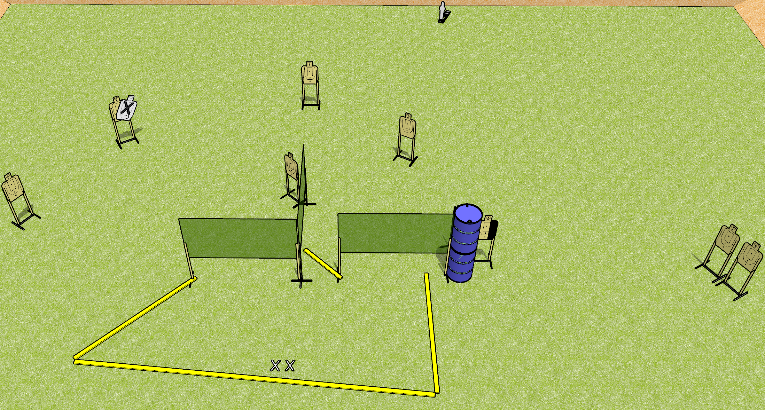
 | Dothan Gun Club – USPSA Match Thrown Down Course Designer : Drew Coleman
19 rounds 9 USPSA targets 1 mini popper
Equipment List 5 wall feet 1 medium or short fault line

Slide 8
Thrown Down
Written Stage Briefing
Thrown Down is a 19 round, 95 point, Comstock medium course. There are 9 USPSA targets and 1 mini popper. The best 2 hits on paper will score, and steel must fall to score. The start signal is audible.
Handgun start position is both feet on X’s, wrists below belt. Handgun is unloaded and holstered.
PCC start position is both feet on X’s. Unloaded carbine is held with both hands, stock on belt, safety on.
On start signal, engage targets as they become available from within the shooting area.

Slide 9
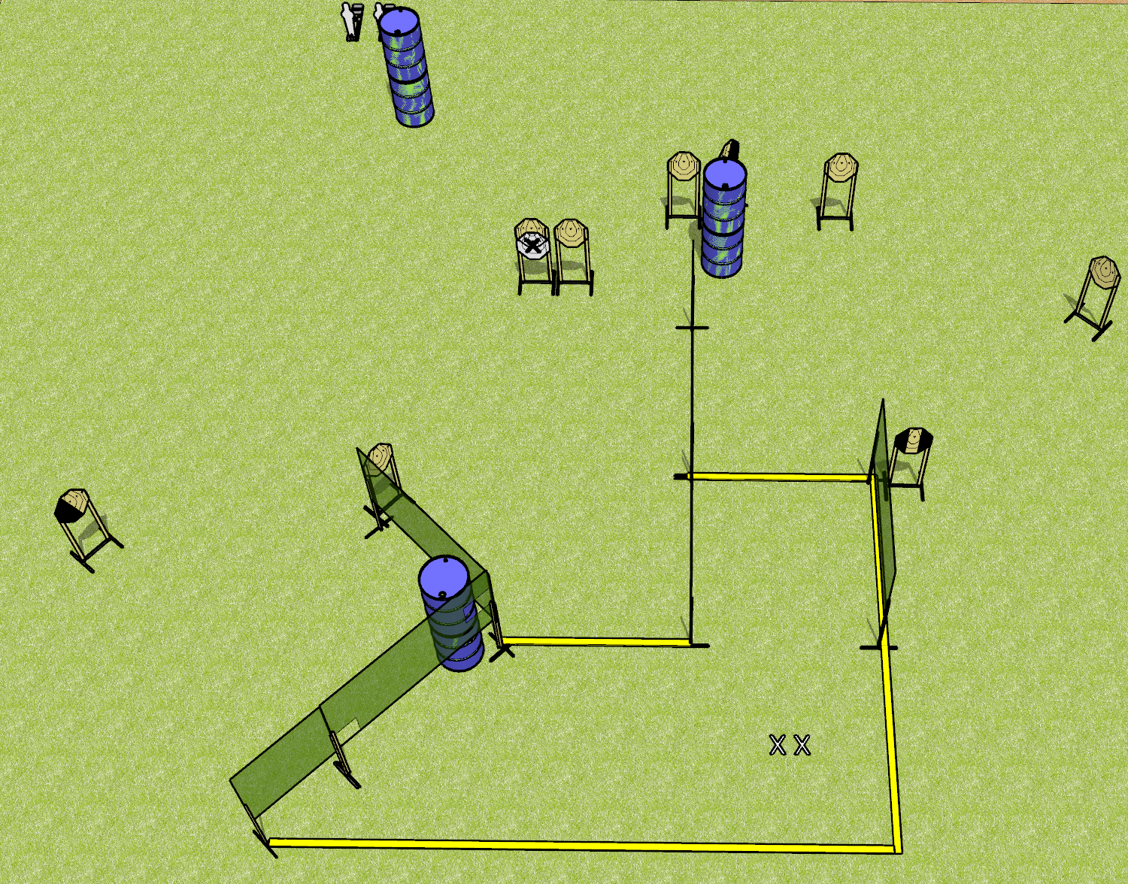
 | Dothan Gun Club – USPSA Match Digging In Course Designer : Drew Coleman
20 rounds 9 IPSC 2 mini poppers
Equipment List 9 wall feet 1 medium fault line

Slide 10
Digging In
Written Stage Briefing
Digging In is a 20 round, 100 point, Comstock course of fire. There are 9 IPSC targets and 2 mini poppers. The best 2 hits on paper will score, and steel must fall to score. The start signal is audible.
Handgun start position is both feet on X’s, wrists below belt. Handgun is loaded and holstered.
PCC start position is both feet on X’s. Loaded carbine is held with both hands, stock on belt, safety on.
On start signal, engage targets as they become available from within the shooting area.

Slide 11
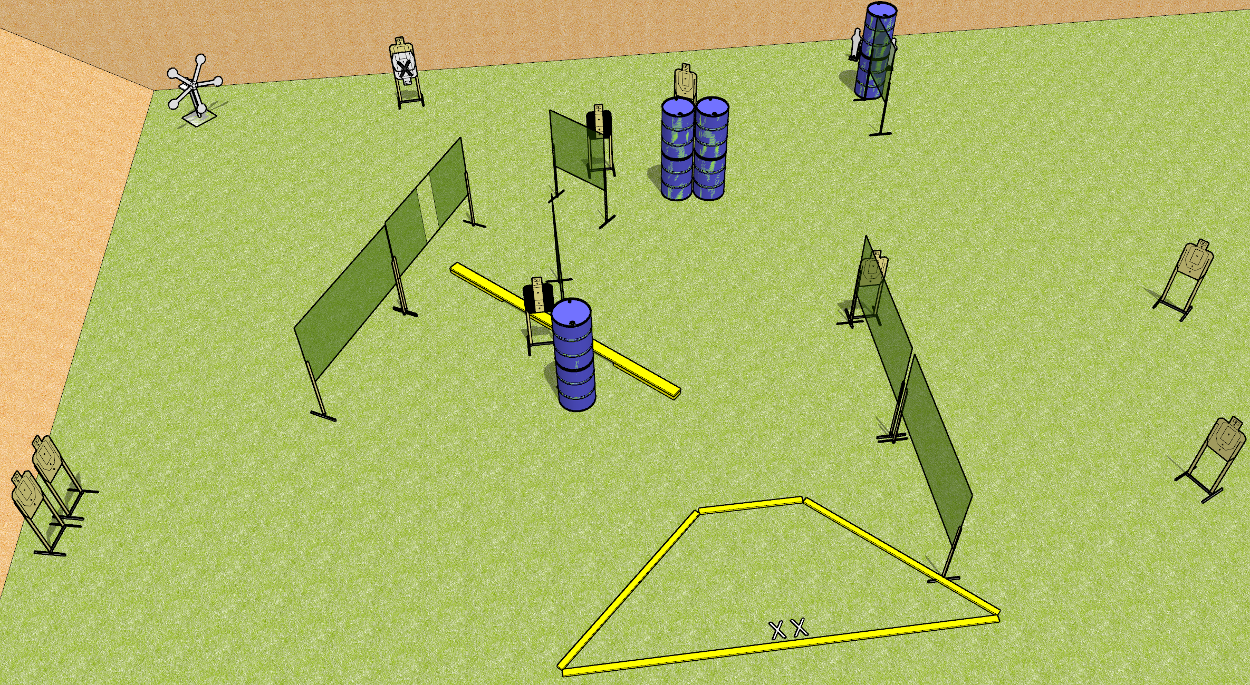
 | Dothan Gun Club – USPSA Match Gamma Rayz Course Designer : Patrick Free
25 rounds 9 USPSA 5 falling plates, 2 mini poppers
Equipment List 1 Texas star 12 wall feet Balance beam 1 medium fault line 2 Tuxedos

Slide 12
Gamma Rayz
Written Stage Briefing
Gamma Rayz is a 25 round, 125 point, Comstock field course. There are 9 USPSA targets, 5 falling plates, and 2 mini poppers. The best 2 hits on paper will score, and steel must fall to score. The start signal is audible.
The balance beam is part of the shooting area.
Handgun start position is both feet on X’s, wrists above shoulders. Handgun is loaded and holstered.
PCC start position is both feet on X’s. Loaded carbine is held with both hands, stock on belt, safety on.
On start signal, engage targets as they become available from within the shooting area.

Slide 13
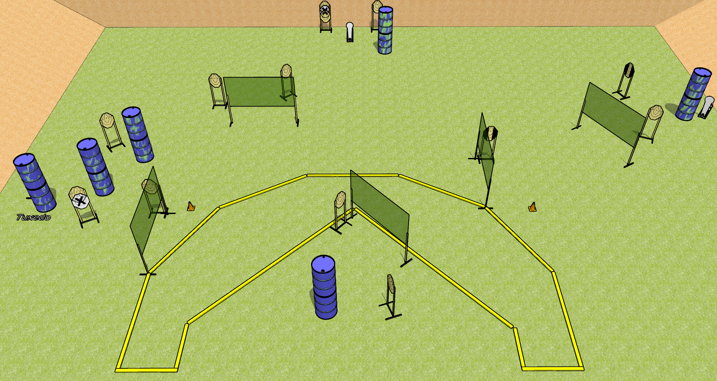
 | Dothan Gun Club – USPSA Match Something or Other Course Designer : Drew Coleman
31 Rounds 15 IPSC targets 1 colt popper
Equipment List 10 wall feet 2 medium fault lines 3 tuxedos

Slide 14
Something or Other
Written Stage Briefing
Something or Other is a 31 round, 155 point, Comstock field course. There are 15 IPSC targets and 1 colt popper. The best 2 hits on paper will score, and steel must fall to score. The start signal is audible.
Handgun start position is heels against either rearmost fault line (circled on diagram), outside the shooting area, facing uprange, wrists above shoulders. Handgun is loaded and holstered.
PCC start position is toes against either rearmost fault line, outside the shooting area. Loaded carbine is held with both hands, shouldered, pointed at either orange cone.
On start signal, engage targets as they become available from within the shooting area.

Slide 15
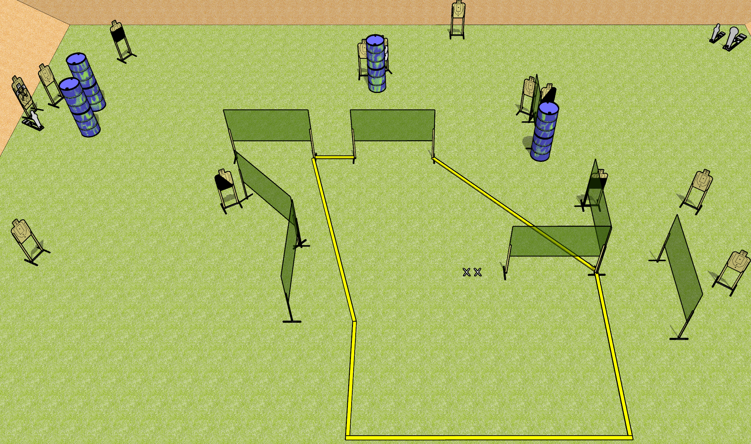
 | Dothan Gun Club – USPSA Match Big Chicken Course Designer : Drew Coleman
31 rounds 14 USPSA 1 colt popper, 2 mini poppers
Equipment List 15 wall feet 1 left and 1 right diagonal HC, 2 50% Far left target near mini popper is 2 + NS

Slide 16
Big Chicken
Written Stage Briefing
Big Chicken is a 31 round, 155 point, Comstock field course. There are 14 USPSA targets, 1 colt popper, and 2 USPSA mini poppers. The best 2 hits on paper will score, and steel must fall to score. The start signal is audible.
Handgun start position is both feet on X’s, wrists below belt. Handgun is loaded and holstered.
PCC start position is both feet on X’s. Loaded carbine is held with both hands, stock on belt, safety on.
On start signal engage targets as they become available from within the shooting area.

